Slide 1


Freshpet Inc.
Genesis Grant, Antonio Lindsay, Shanysse Alexander, Lisa Jing

Slide 2
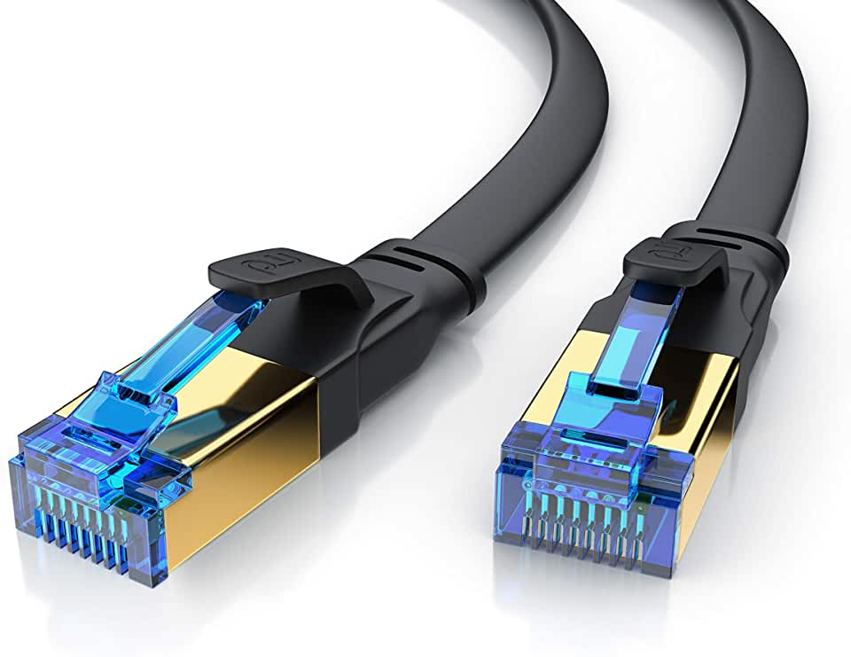
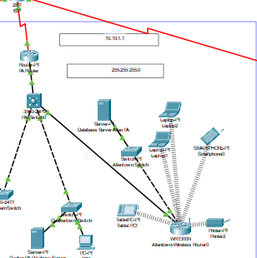
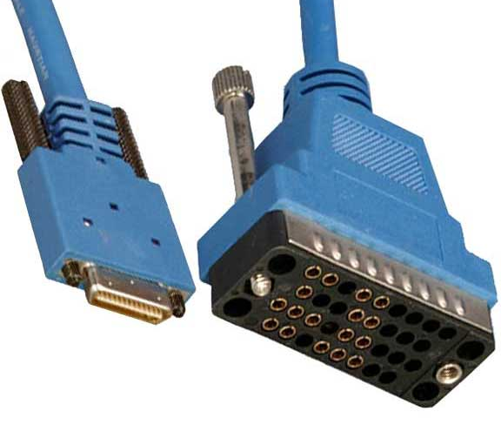
Layer 1- Physical
Switch to Router (Gigabit Ethernet cable)
Switch to Device (Fast Ethernet cable)
Router to Server (Gigabit Ethernet cable)
Router to Router (Serial DCE)
Switch to Switch (Copper Cross-Over)

Slide 3
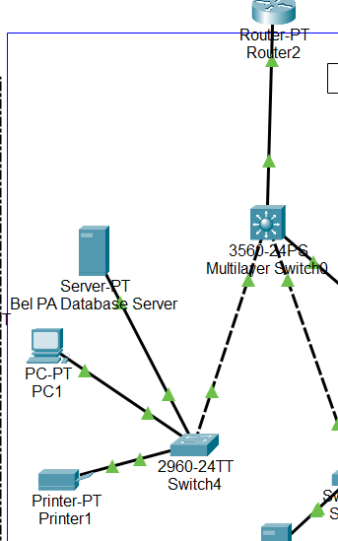
Layer 2 – Data Link
Devices connected through the different cables
This layer ensures that the devices are communicated properly.

Slide 4
Layer 3 - Network
The network layer handles data transfer between different networks. If the two devices are on the same network, then the network layer is unnecessary. The network layer breaks up segments from the transport layer into smaller packets on the sender’s device, and reassembling these packets on the receiving device. The network layer also finds the best physical path for the data to reach its location
ICMP the IGMP and the IPsec suite.

Slide 5
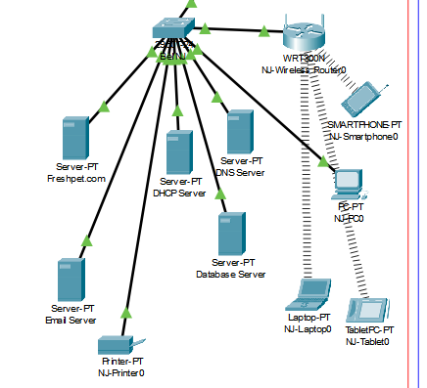
Layer 7 – Application
Freshpet.com (HTTP)
DHCP & DNS – users/company
Email Server
Database Servers

Slide 6
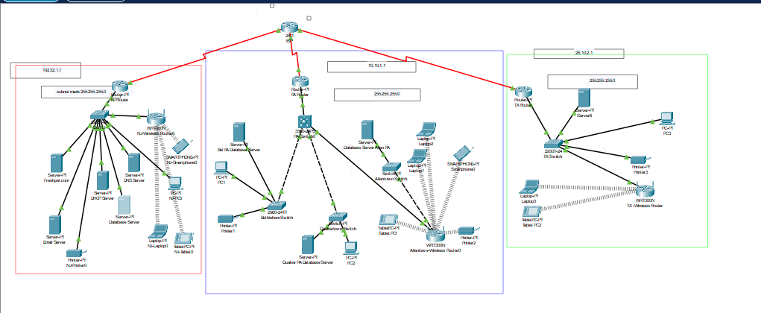
References (APA)
WAN TOPOLOGY TYPES. (2019, April 24). IPCISCO.com. https://ipcisco.com/wan-topology-types/
IT-Made-Easy. (2021, July 5). OSI Model animated, What is osi model in networking? 7 OSI layers explained [Video]. YouTube. https://www.youtube.com/watch?v=Ca1jnqwqzg0
GeeksforGeeks. (2023). Types of Network Topology. GeeksforGeeks. https://www.geeksforgeeks.org/types-of-network-topology/
Upravnik. (2022). DHCP & DNS Protocols Explained. Study CCNA. https://study-ccna.com/dhcp-dns/
Freshpet Healthy Dog Food and Cat Food, Fresh from the Fridge. (2023, April 13). Freshpet. https://freshpet.com/#/

